Slide 1



Professional Practice Final Seminar Presenter: Hai Nguyen

Slide 2
Agenda
Introduction to the company & my intern position
What I was responsible for
What I learnt from my daily tasks
What I aim to improve after my internship

Slide 3

Introduction to the company & my intern position

Slide 4


FLYER TECHNOLOGY JOINT STOCK COMPANY
flyer.us

Slide 5
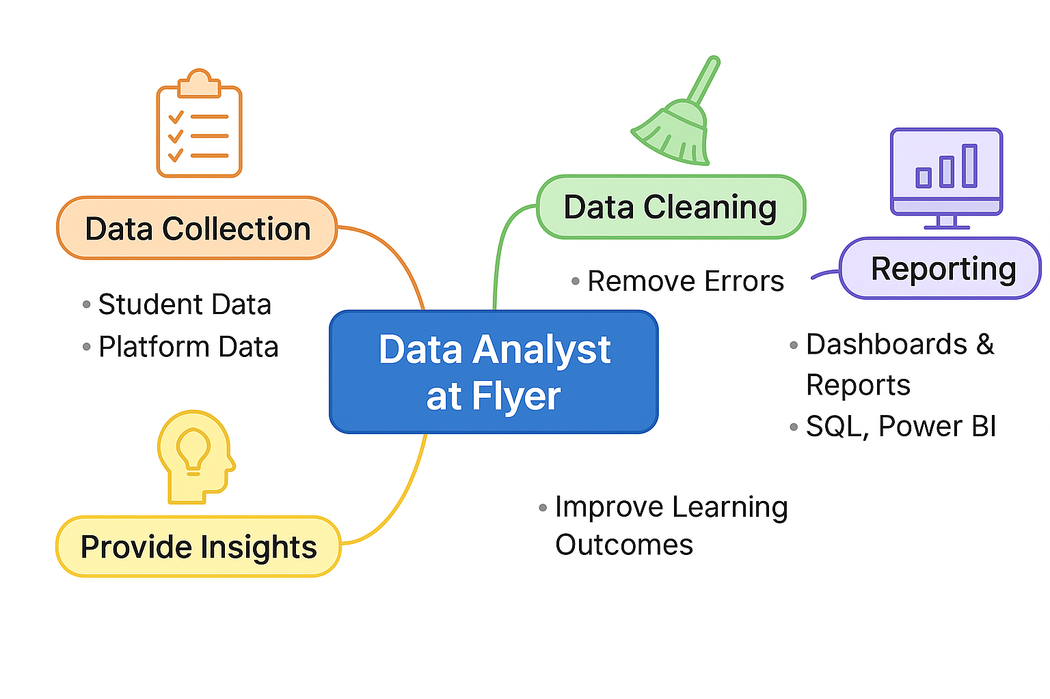
My intern position – Data analyst
Data analyst: A data analyst is responsible for collecting, organizing, and studying data to provide valuable business insights.

Slide 6

What I Was Responsible For

Slide 7
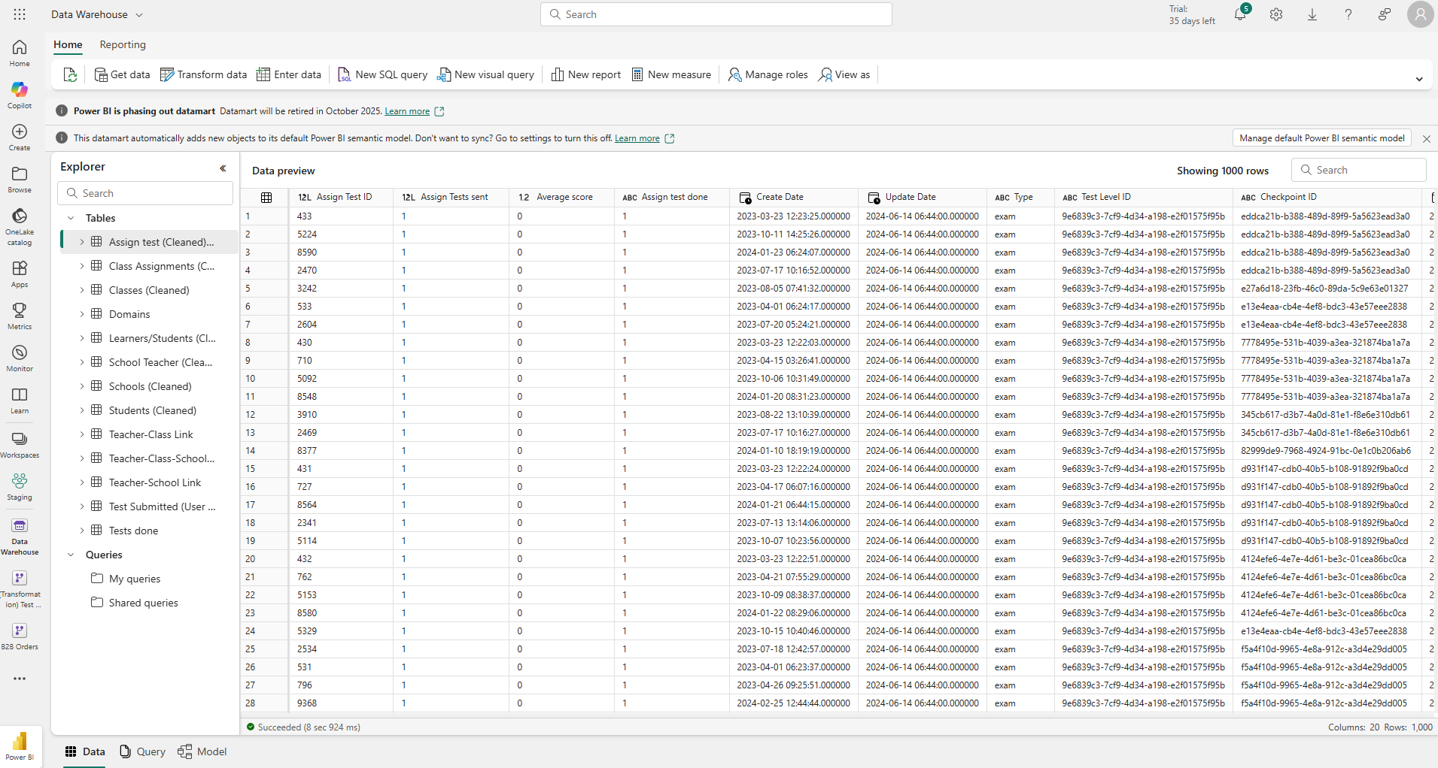
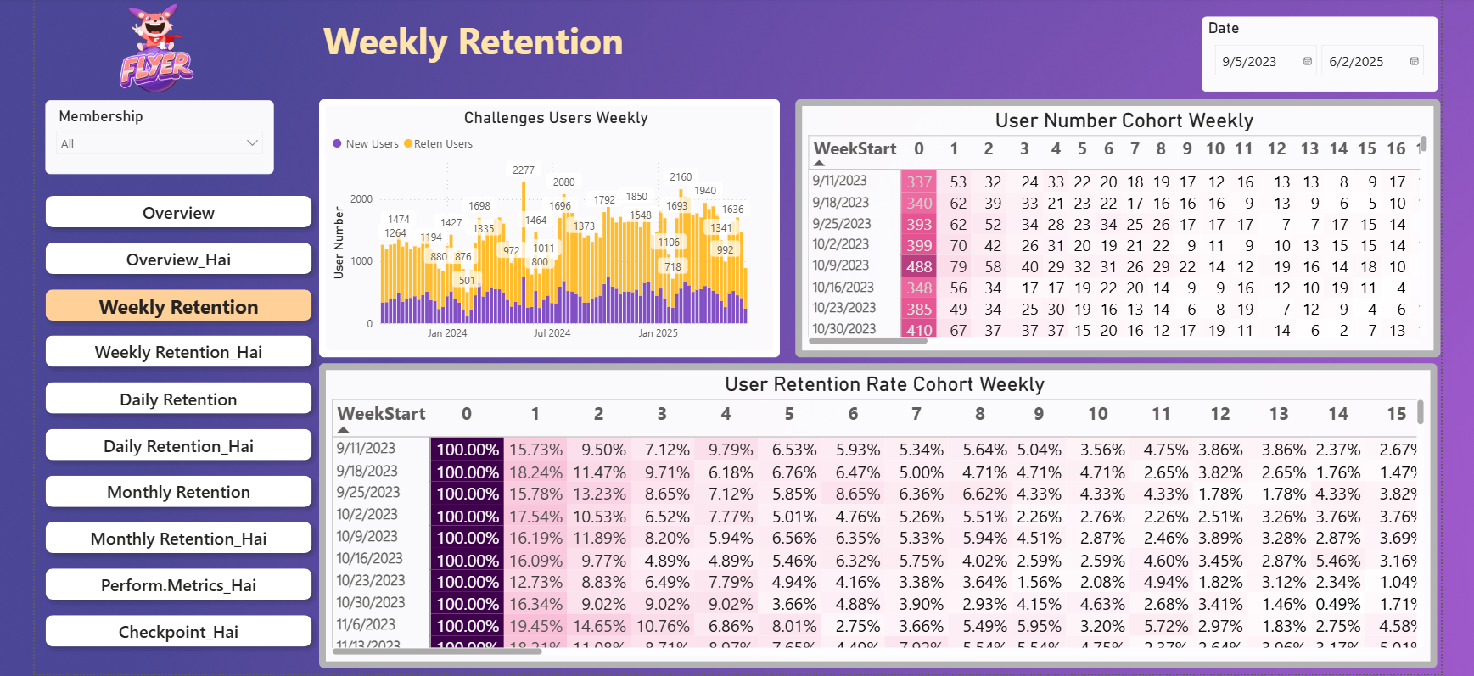
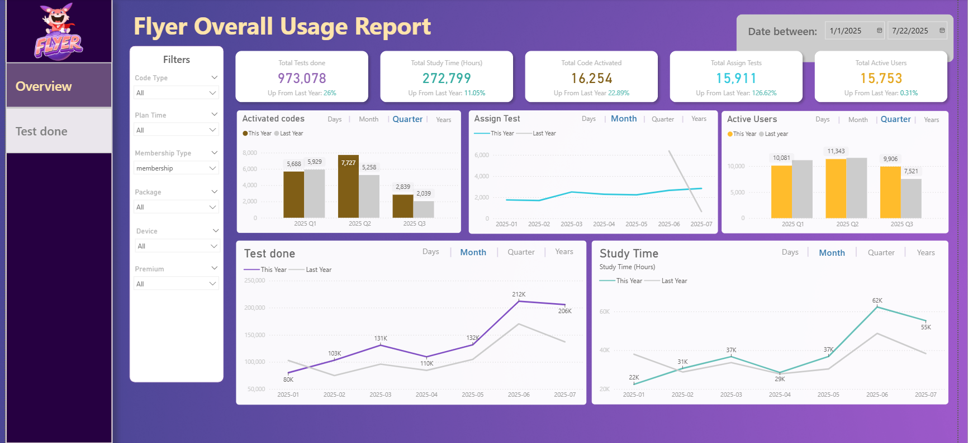
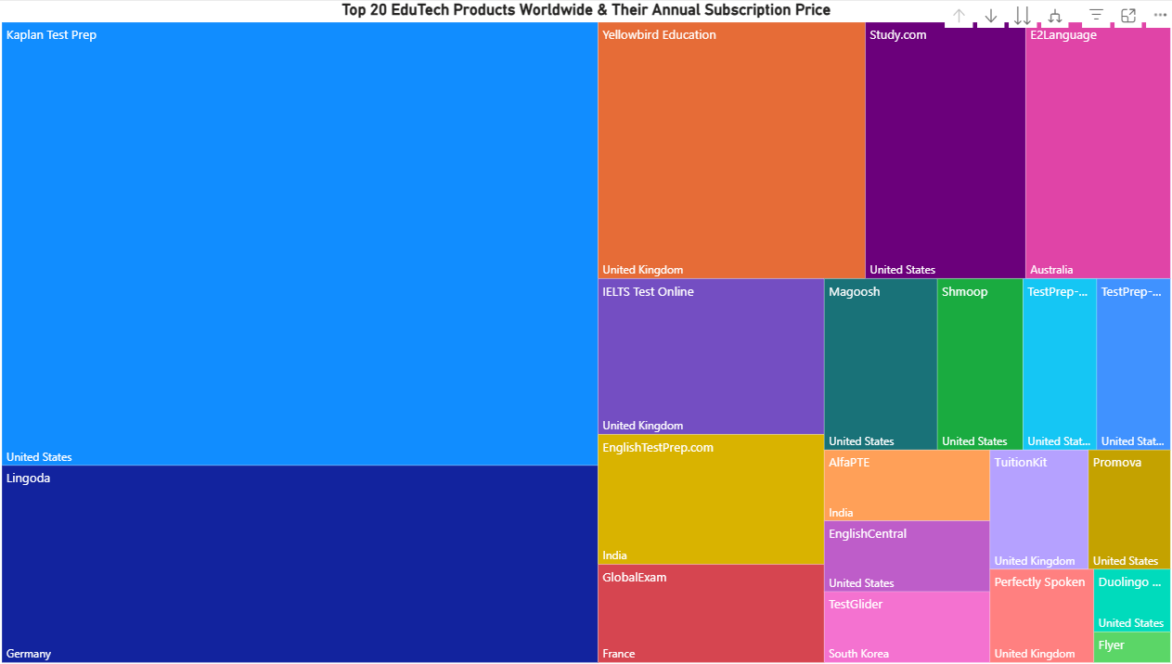
Transforming Data into Actionable Insights using Power BI

Slide 8
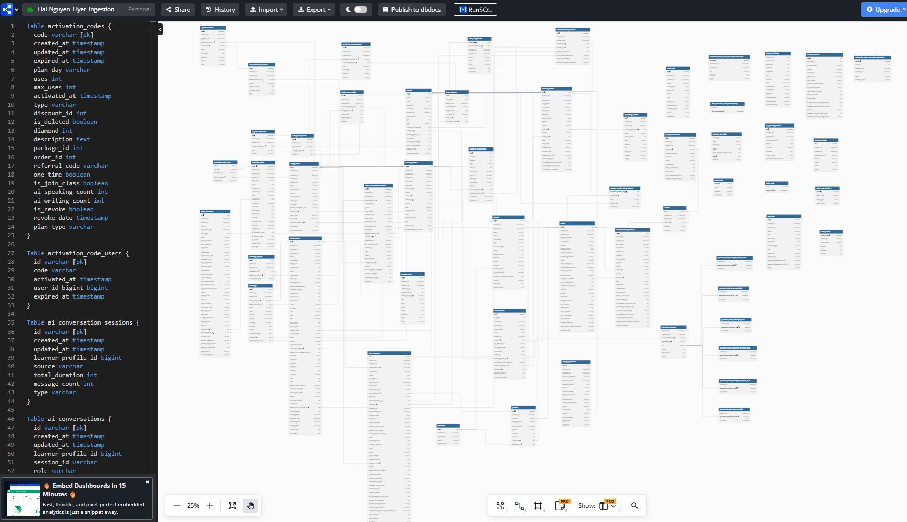
Database Schema Design for Learning Analytics
Design relational schema to organize student, test and platform data for efficient analytics
Ensure clear relationship between tables to support advanced reporting & Power BI integration
Optimize field types and keys for data quality, scalability and easy maintenance

Slide 9
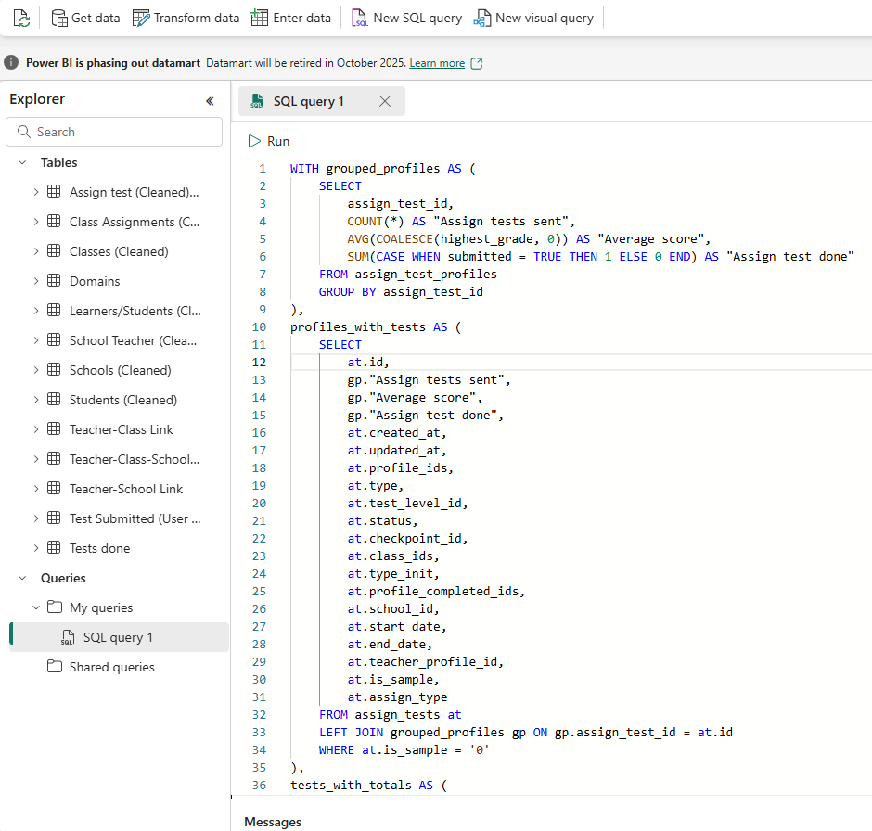
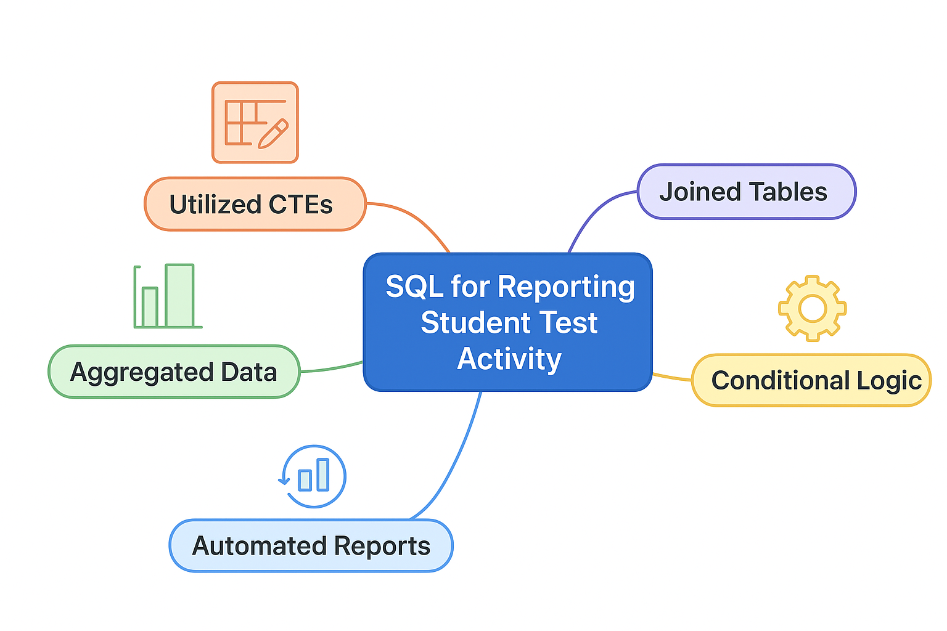
SQL Data Processing for EdTech Insights
Organize complex queries for reporting student test activity
Aggregated data to calculate metrics such as “Assign tests sent,” average scores, and “Assign test done.”
Joined multiple tables to enrich the dataset for analysis and visualization in Power BI.

Slide 10
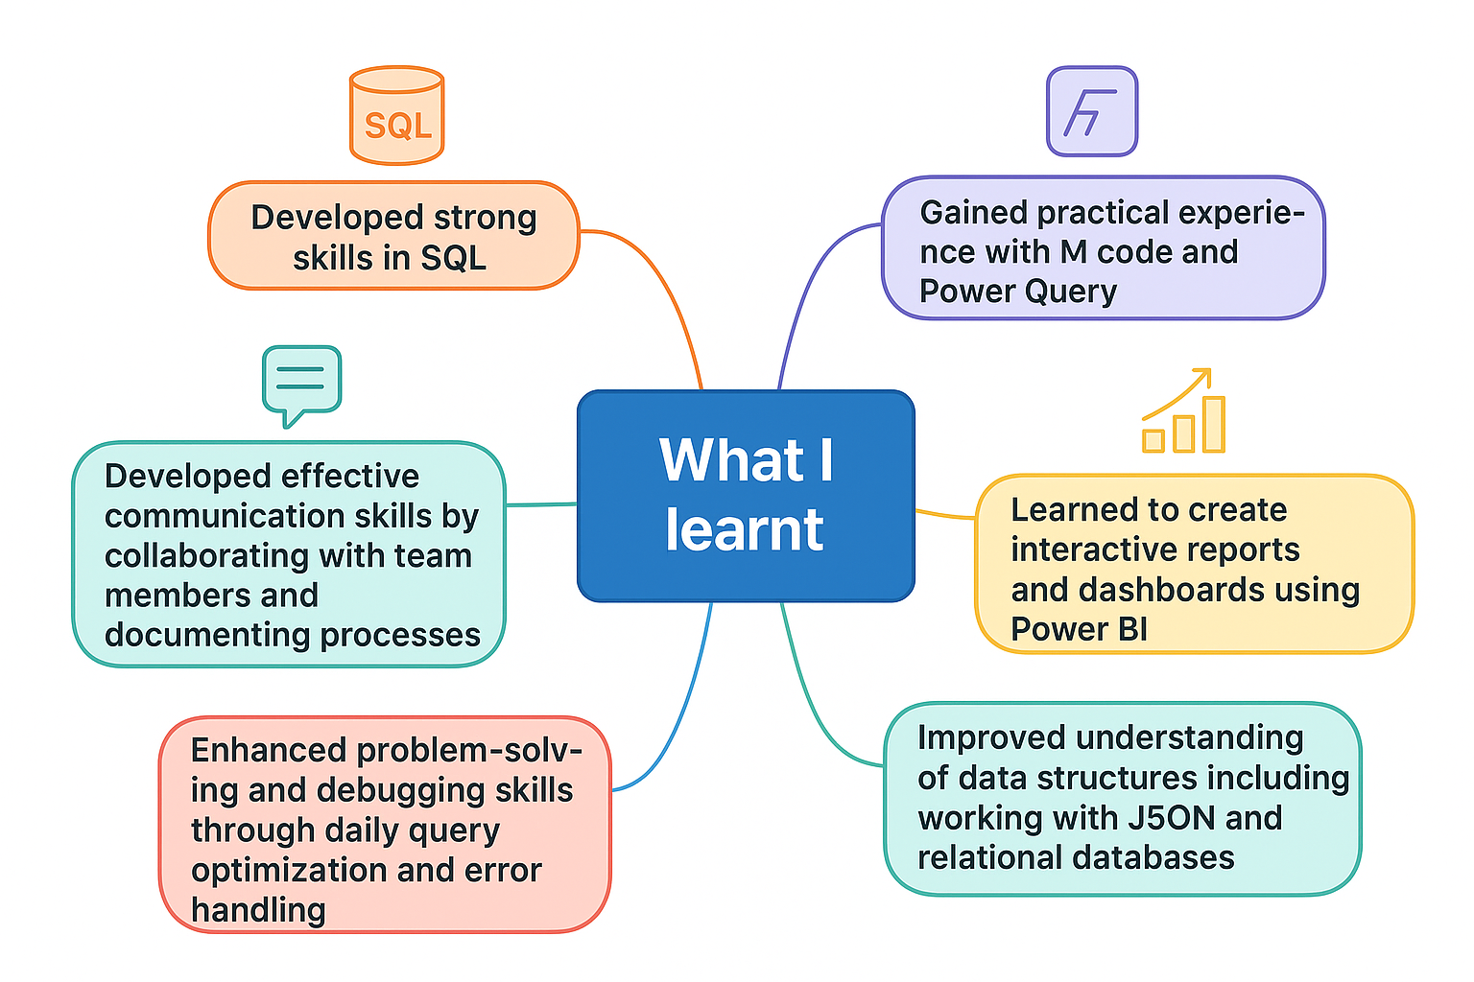
What I learnt from my daily tasks

Slide 11
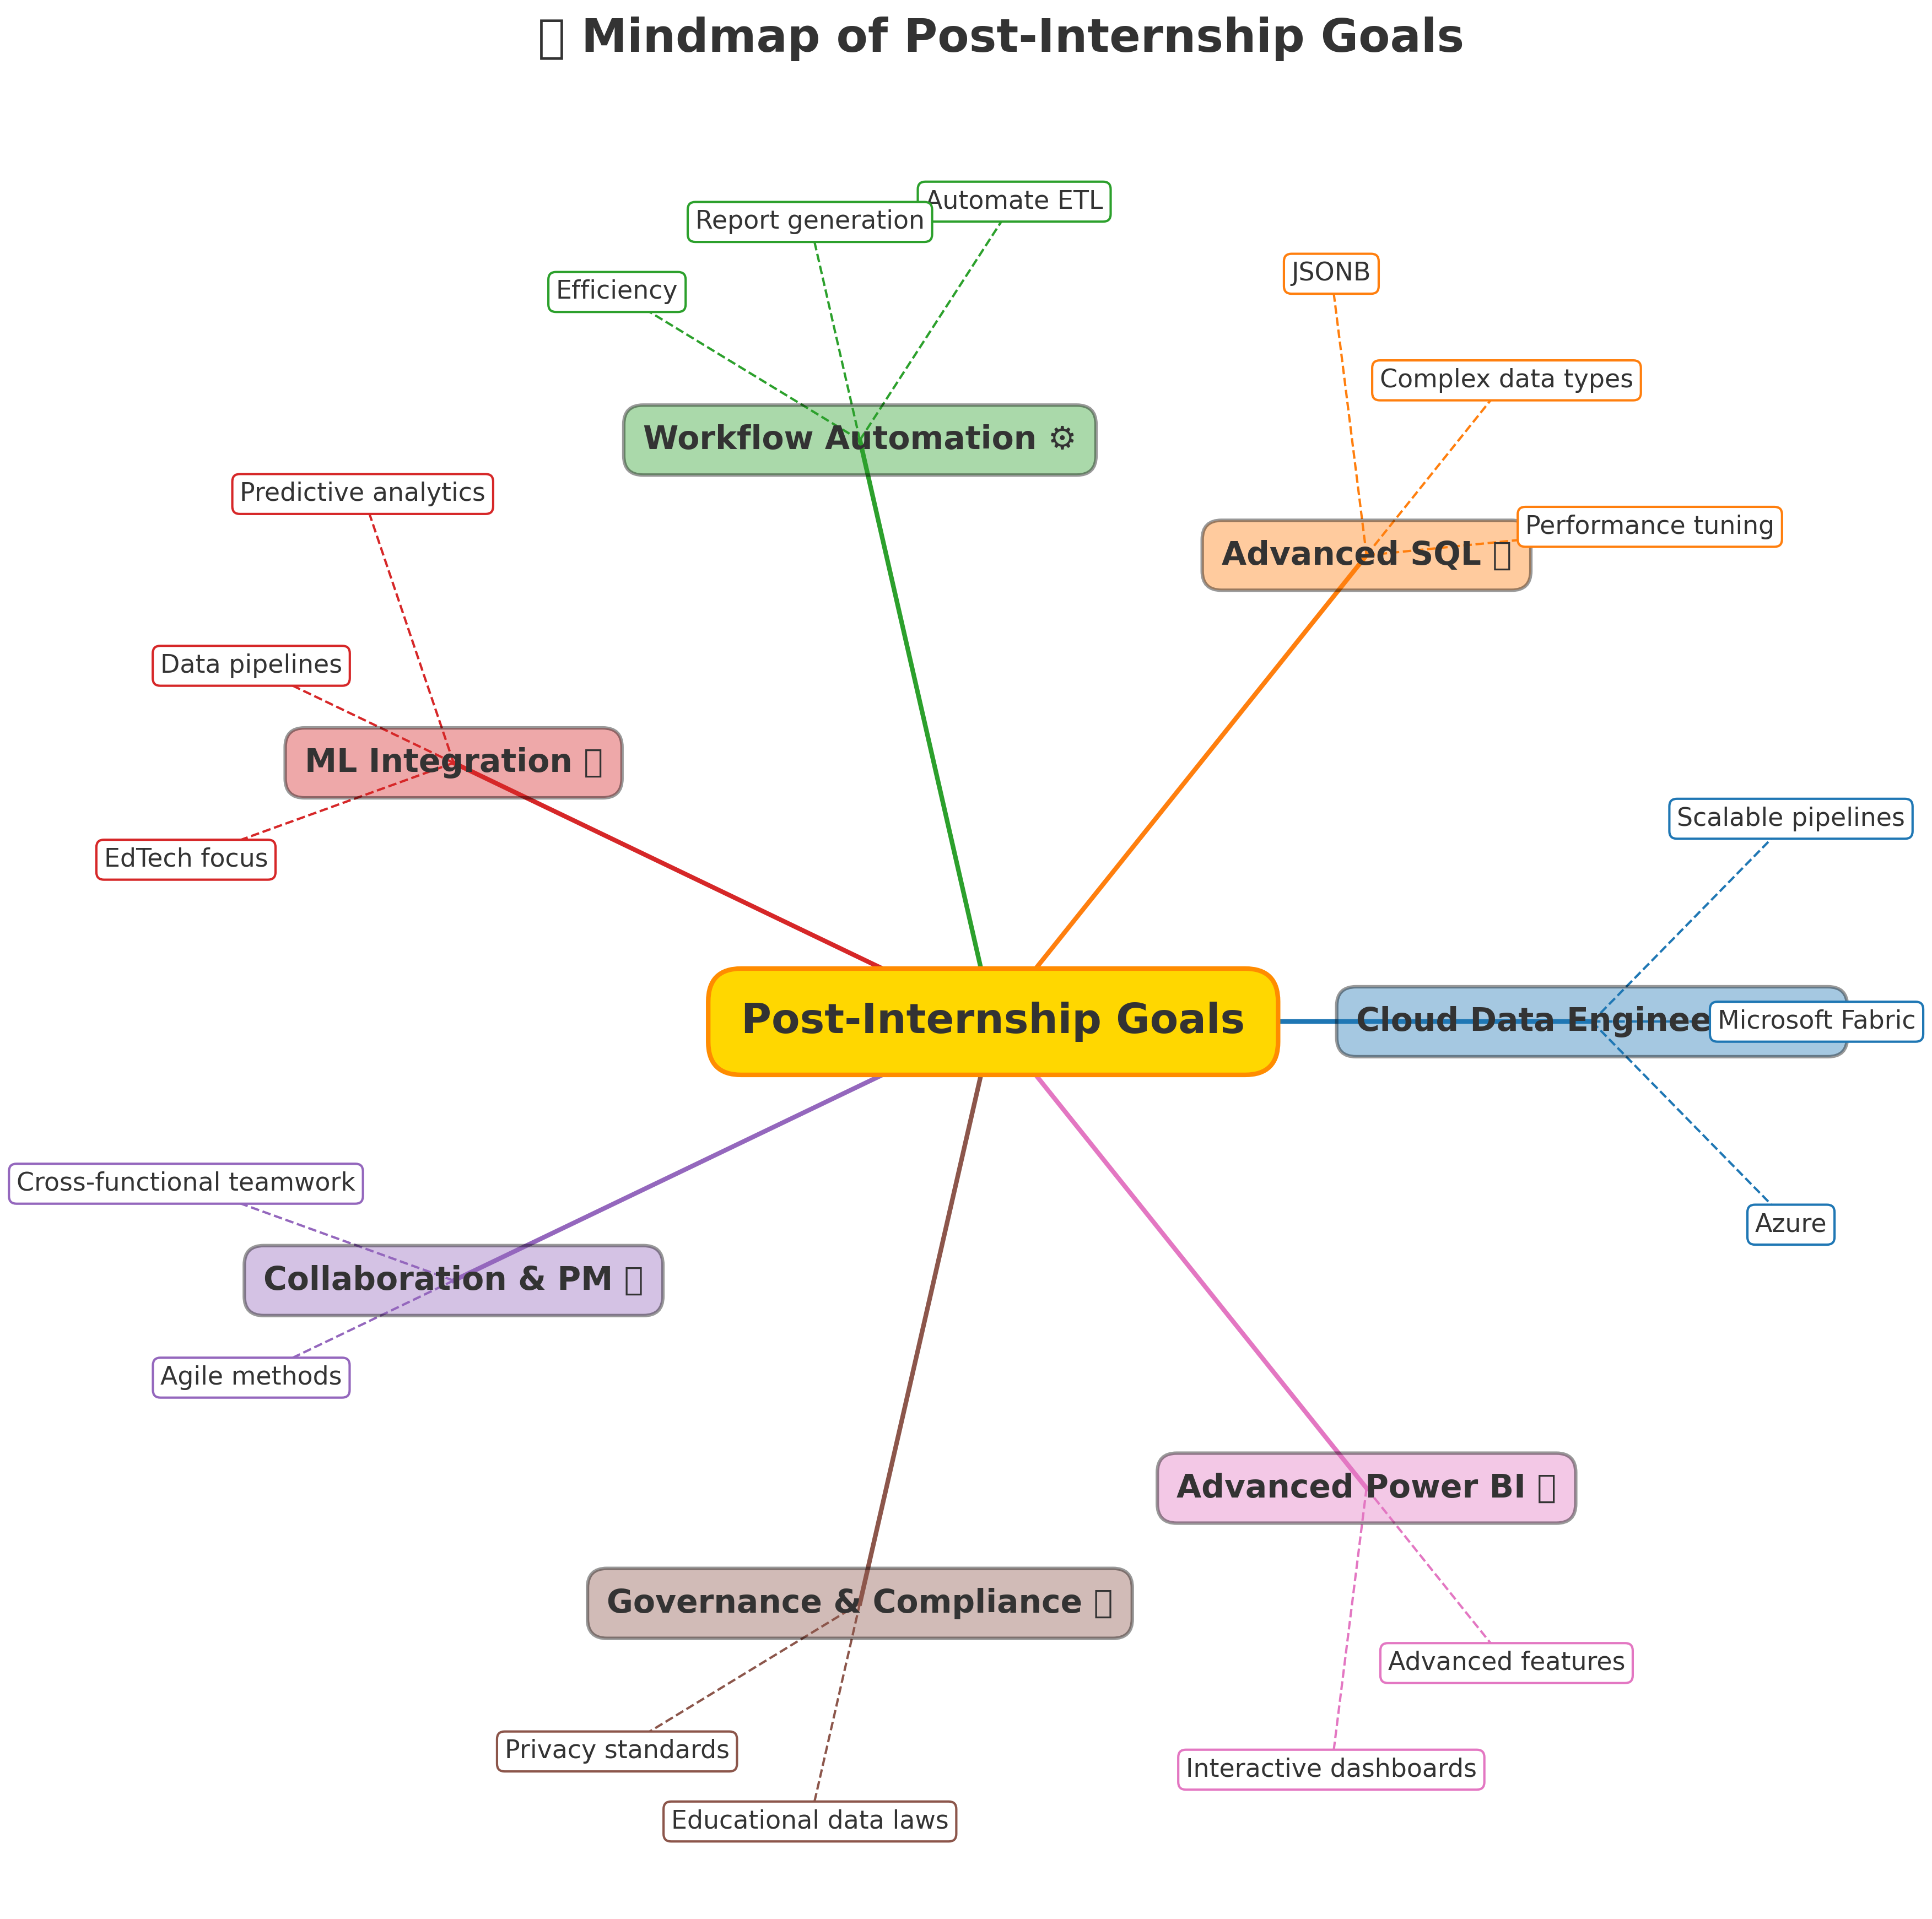
What I aim to improve after my internship

Slide 12
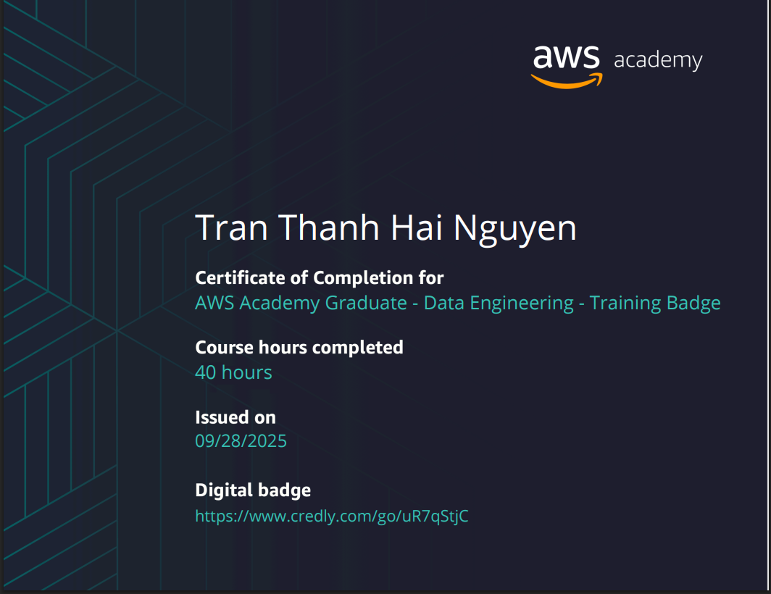
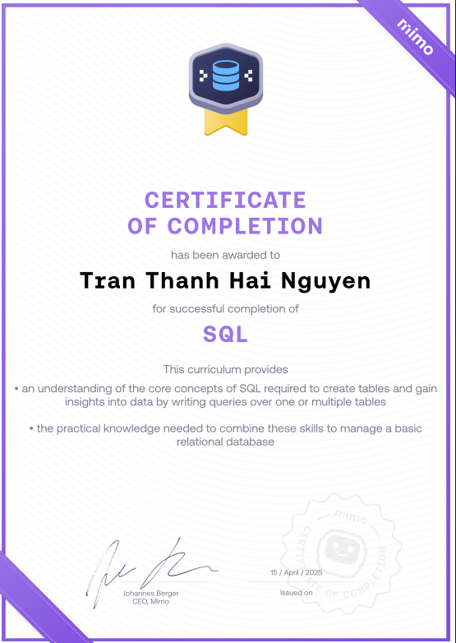
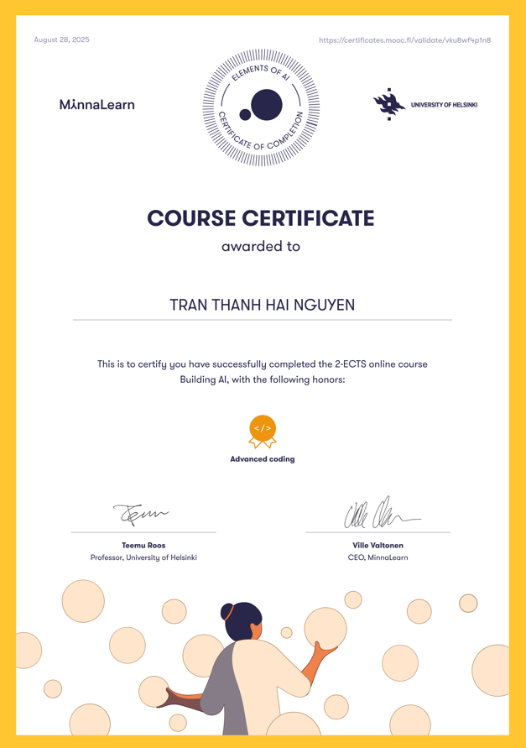

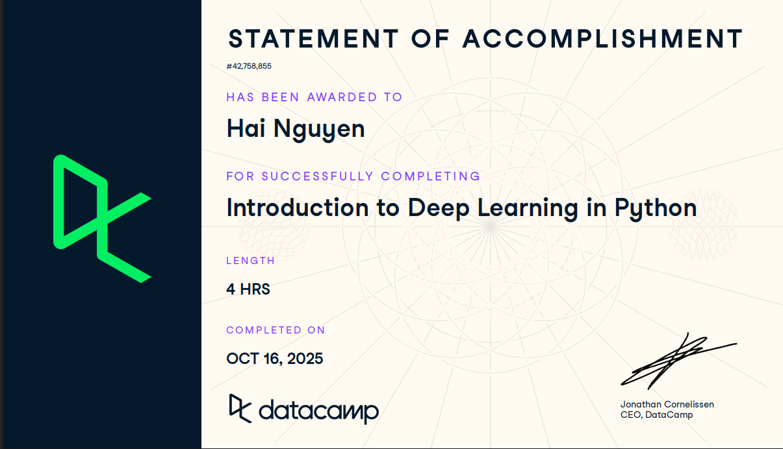
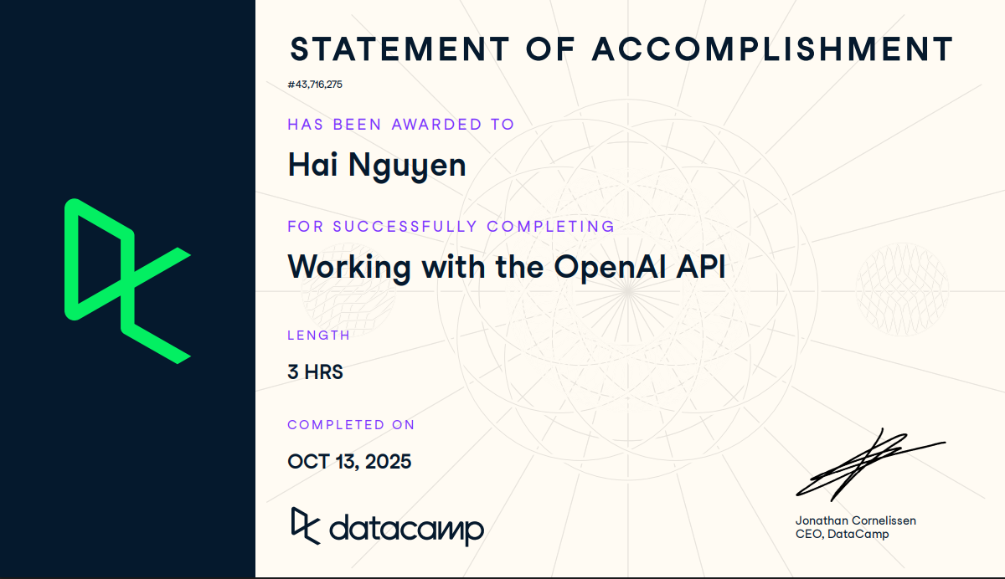

Slide 13

An AI-Powered Finnish Speaking Practice App

Slide 14
Thank you!
Hai Nguyen
hai.nguyen@edu.turkuamk.fi

